Slide 1

Sports League Management System
DAMG6210 – Project Presentation
Group 17
- Reetesh Kesarwani
- Shreyangi Prasad (POC)
- Lakshmi Kantha Monisha Pulavarthy
- Khushbu Singh
- Manjari Chaturvedi

Slide 2

Overview
Key Features
Comprehensive Data Management
Performance Enhancement
Strategic Decision Support
Competitive Edge
Fan Engagement Tools
Purpose
Enhance player performance through data-driven insights.
Facilitate strategic decision-making for sports organizations.
Elevate fan engagement to new heights.

Slide 3
Design Documents
Relationships/Business Rules
1. Viewers engage in Transactions for matches.
2. Coaches are affiliated with Teams.
3. Teams include Match Players.
4. Players enter into Contracts with Teams.
5. Players have Player Statistics records.
6. Matches involve multiple Transactions.
7. Matches have Player Statistics entries.
8. Admins are responsible for Stadiums.
9. Stadiums optionally host Matches.
10. Match Result associates Matches with winning Teams.
Supertype/Subtype Relationships
- User (Supertype): Generalized entity with Viewer, Coach, Player, Admin subtypes.
- Player (Supertype): Specialized into Match Player and Substitute Player.
Associative Entities
- Match Result, Player Statistics, Transaction, Contract.

Slide 4
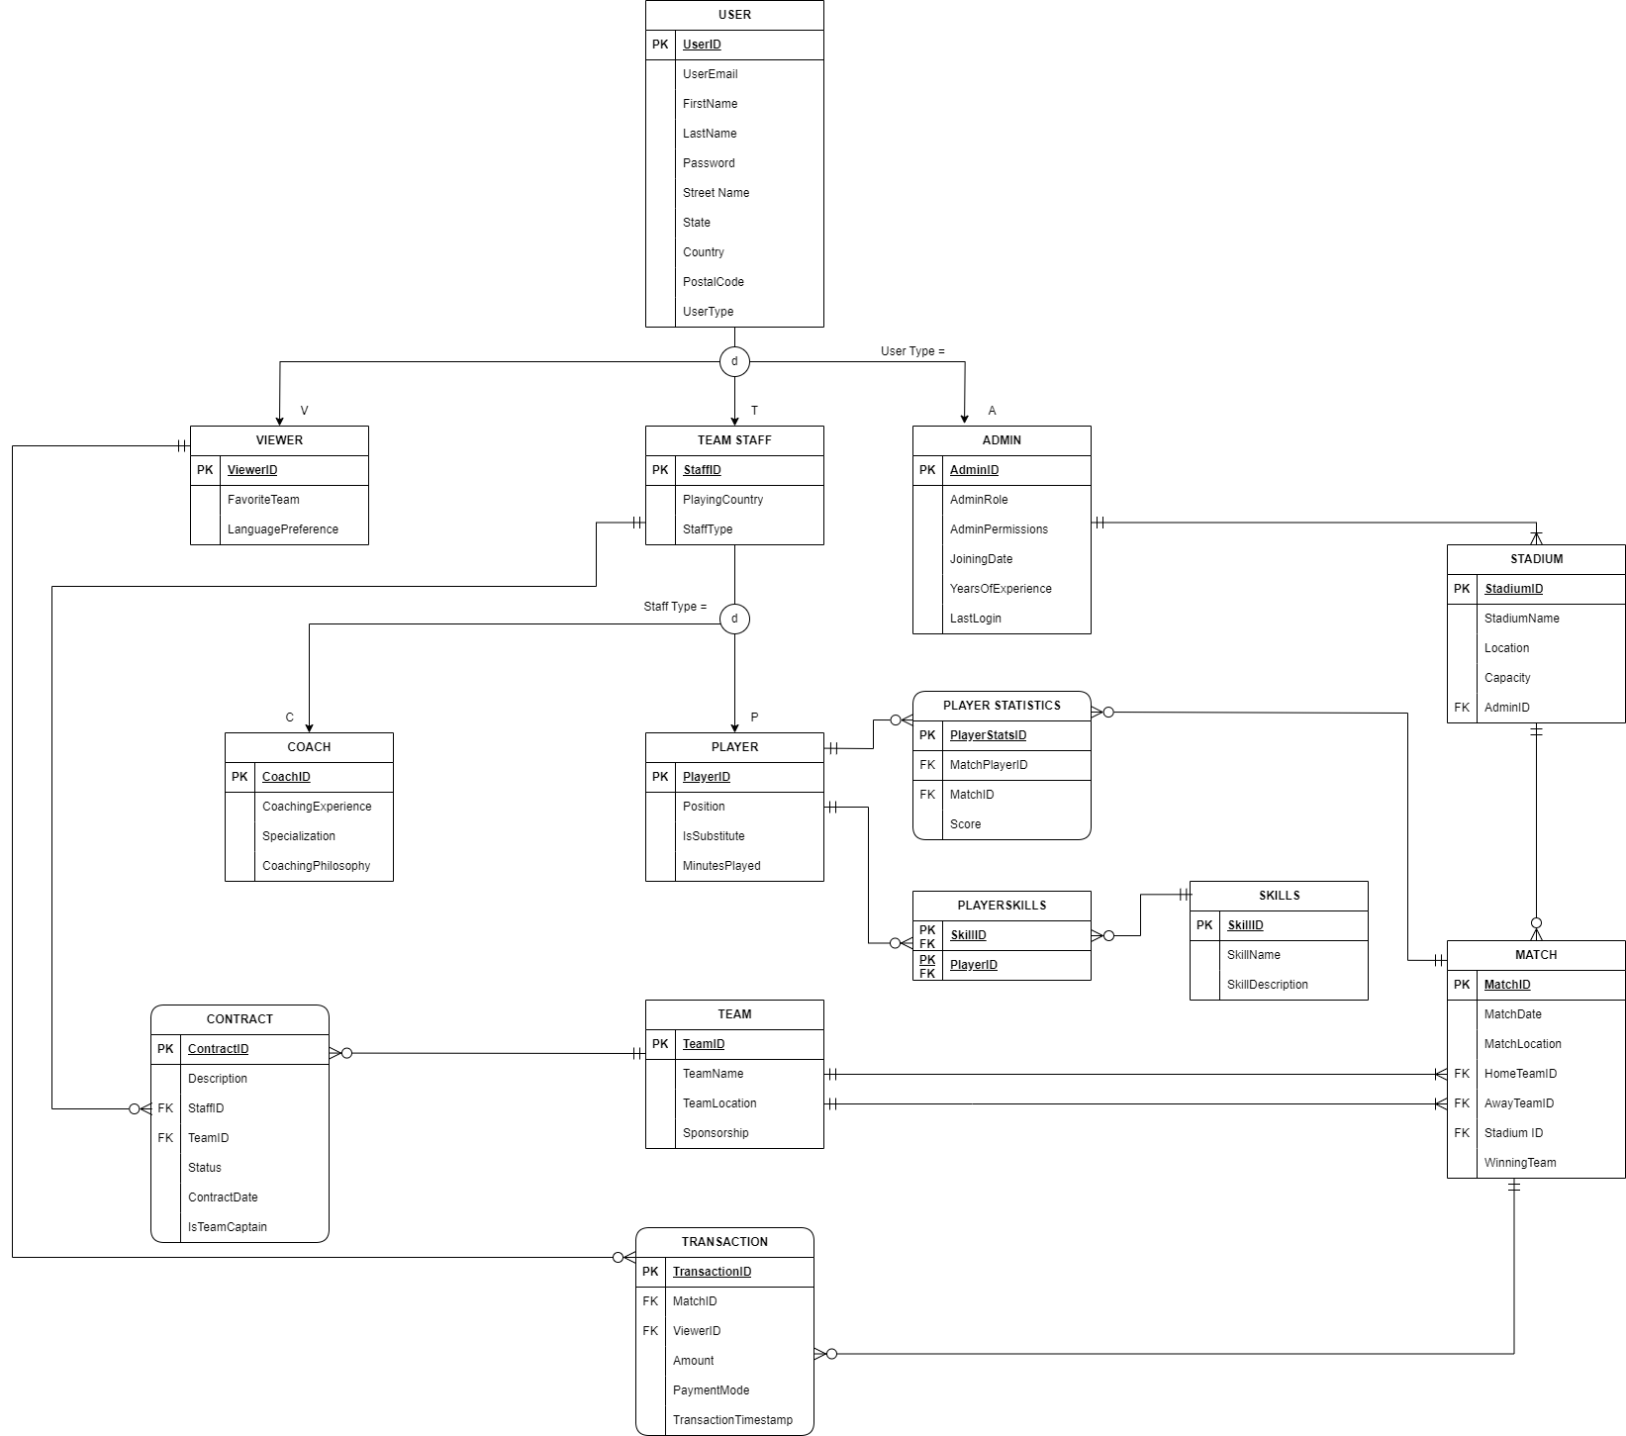
E-R Diagram

Slide 5
Views and Triggers
Trigger on Updating the Stadium for a Match
CREATE OR ALTER TRIGGER trgMatchStadiumUpdate ON [match]
AFTER UPDATE
AS
BEGIN
SET NOCOUNT ON;
IF UPDATE(stadiumId)
BEGIN
INSERT INTO MatchStadiumAudit (
matchId,
oldStadiumId,
oldStadiumName,
oldStadiumLocation,
newStadiumId,
newStadiumName,
newStadiumLocation,
updateDate
)
SELECT
i.matchId,
d.stadiumId AS oldStadiumId,
s_d.stadiumName AS oldStadiumName,
s_d.[location] AS oldStadiumLocation,
i.stadiumId AS newStadiumId,
s_i.stadiumName AS newStadiumName,
s_i.[location] AS newStadiumLocation,
GETDATE() AS updateDate
FROM inserted i
INNER JOIN deleted d ON i.matchId = d.matchId
JOIN stadium s_d ON d.stadiumId = s_d.stadiumId
JOIN stadium s_i ON i.stadiumId = s_i.stadiumId
WHERE i.stadiumId <> d.stadiumId;
END
END
View for the Preference Transaction of a User
CREATE OR ALTER VIEW ViewerPreferencesTransactions AS
SELECT v.viewerId, u.firstName + ' ' + u.lastName AS viewerName, v.favoriteTeam, v.languagePreference,
COUNT(t.transactionId) AS numberOfTransactions, SUM(t.amount) AS totalSpent
FROM [viewer] v
JOIN [user] u ON v.viewerId = u.userId
LEFT JOIN [transaction] t ON v.viewerId = t.viewerId
GROUP BY v.viewerId, u.firstName, u.lastName, v.favoriteTeam, v.languagePreference;
View for a Detailed Contact Information of Team Staff
CREATE OR ALTER VIEW DetailedContractInfo AS
SELECT c.contractId, c.description, c.startDate, c.endDate, t.teamName,
ts.playingCountry, u.firstName + ' ' + u.lastName AS staffName,
CASE WHEN c.isTeamCaptain = 1 THEN 'Yes' ELSE 'No' END AS isTeamCaptain
FROM [contract] c
JOIN [team] t ON c.teamId = t.teamId
JOIN [teamStaff] ts ON c.teamStaffId = ts.teamStaffId
JOIN [user] u ON ts.teamStaffId = u.userId;

Slide 6

Stored Procedure
Stored procedure to adding a user to admin table when added to user table with additional input for admin parameters
CREATE PROC insertToAdminTable @adminRole NVARCHAR(100), @adminPermissions NVARCHAR(100), @joiningDate DATE AS
BEGIN
DECLARE @message VARCHAR(100)
IF EXISTS (SELECT userId FROM [user] WHERE userType = 'Admin' AND NOT EXISTS (SELECT 1 FROM [admin] WHERE adminId = userId))
BEGIN
DECLARE @yearsOfExperience INT
SELECT @yearsOfExperience=dbo.CalculateYearsOfExperience(@joiningDate)
INSERT INTO [admin] (adminId,adminRole,adminPermissions,joiningDate,yearsOfExperience,lastLogin)
SELECT userId, @adminRole AS adminRole, @adminPermissions AS adminPermissions, @joiningDate AS joiningDate,
@yearsOfExperience AS yearsOfExperience , GETDATE() AS lastLogin
FROM [user] WHERE userType = 'Admin' AND NOT EXISTS (SELECT 1 FROM [admin] WHERE adminId = userId)
END
END

Slide 7
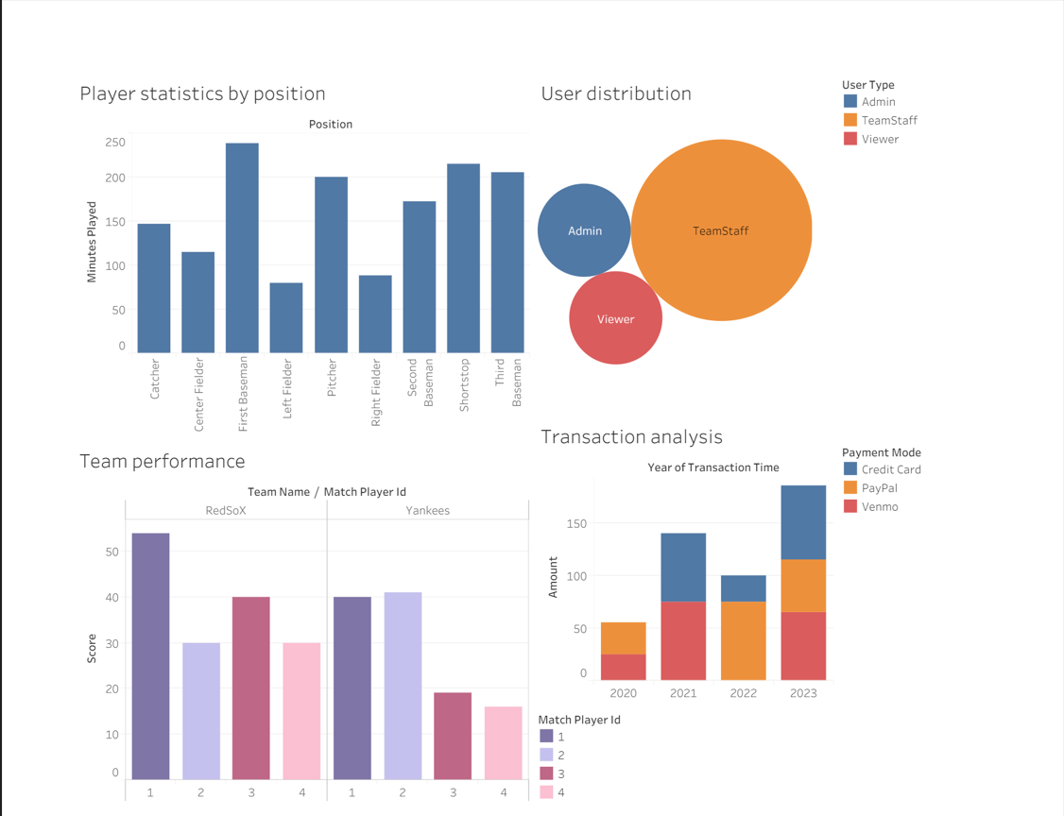
Data Visualization Using Tableau

Slide 8
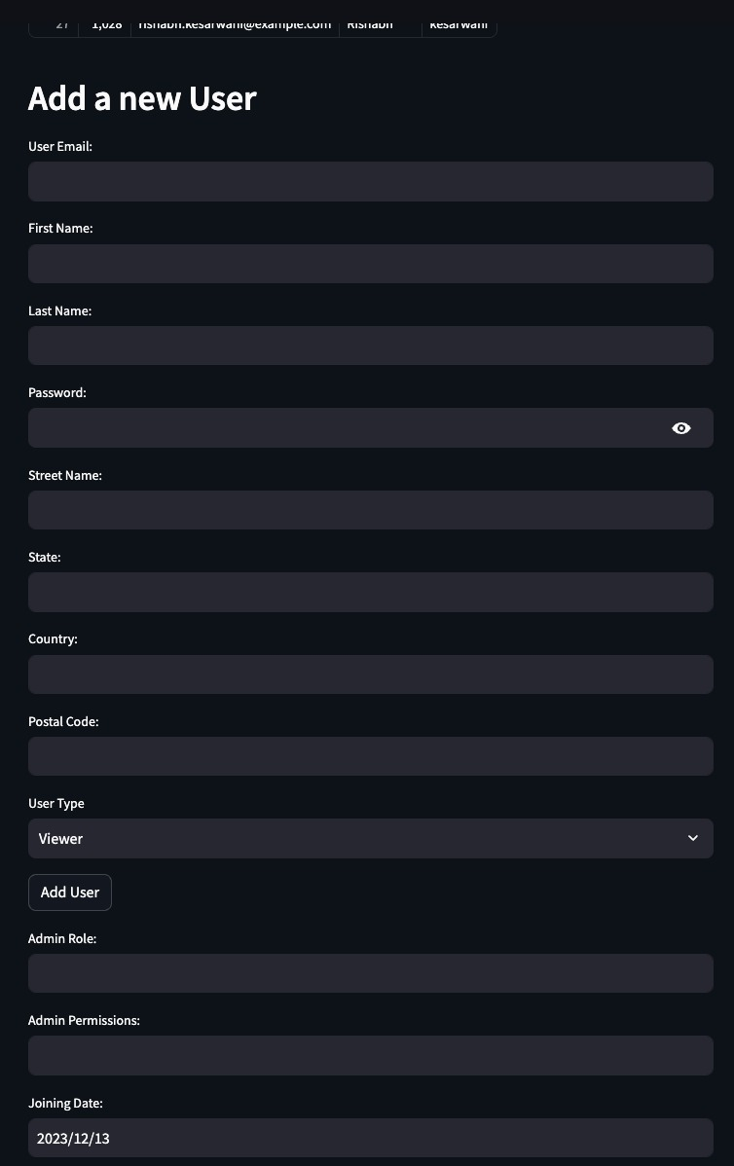
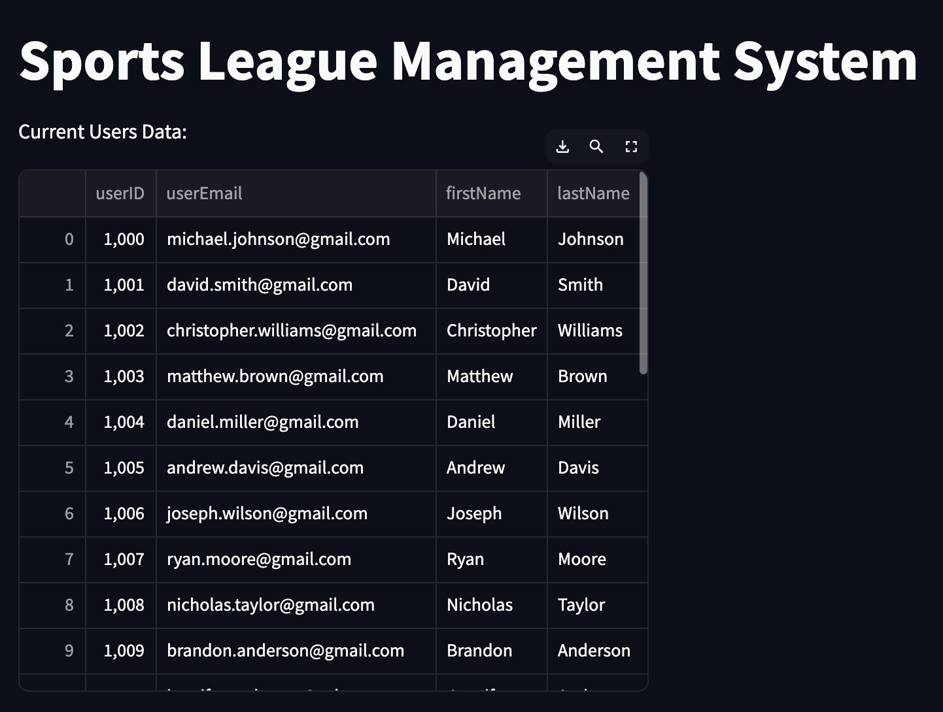
GUI REPORTS

Slide 9
DEMO

